Slide 1
DINING ETIQUETTE
& TABLE MANNERS
What Everyone Needs to Know
From Casual Eats to Fine Dining — Confidence at Every Table
An Essential Life Skills Workshop

Slide 2
Why Dining Etiquette Matters in 2025
⭐ First Impressions Count
💼 Career & Academic Edge
Research shows it takes just 7 seconds to form a first impression , dining confidently sets you apart in interviews, dates, and family events.
Business meals are increasingly common. Teens who master dining etiquette are better prepared for internships, college interviews, and networking events.
🌍 Cultural Awareness
Mutual Respect
Understanding table manners shows respect for diverse cultures and backgrounds — a critical 21st-century skill in our globalised world.
Good table manners reflect respect for your host, fellow diners, and the effort behind every meal. It transforms eating into a social experience.

Slide 3
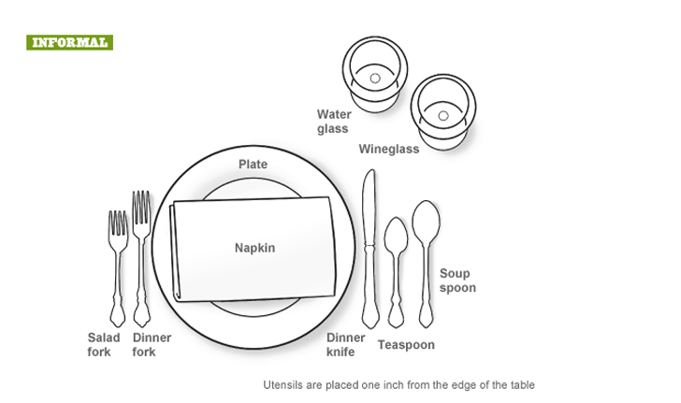
Reading the Table Setting
Quick Rules
BMW Rule
Bread (left), Meal (center), Water (right)
Outside In
Use utensils from the outermost inward with each course
Napkin First
Unfold napkin onto lap as soon as seated
Rest Position
Fork & knife crossed on plate = still eating

Slide 4
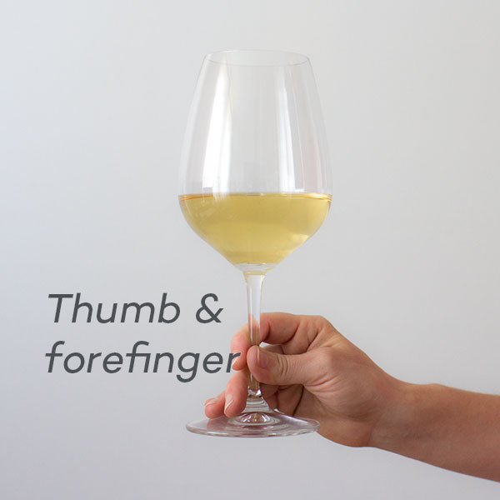

How to hold the wine glass

Slide 5
The Art of the Napkin
✅ DO
❌ DON'T
Place on your lap as soon as you sit (fold half if large)
Use corner to dab — never wipe — your mouth
Set on chair if leaving temporarily
Place loosely folded to LEFT of plate when meal ends
Use to discreetly remove food from mouth
Tuck into collar or waistband
Wave it around or shake it open dramatically
Use it to blow your nose at the table
Place on the table until the meal is completely over
Leave it crumpled or balled up

Slide 6
Ordering with Confidence
01
Scan the full menu
02
Don't order first
Read all sections — appetizers, mains, sides, desserts — before deciding. Know the price range so your order is appropriate for the occasion.
Let the host or eldest person order first. This also gives you time to gauge portion sizes and the formality of the meal.
03
Speak clearly to the server
04
Match course count
Say 'I'd like...' not 'Gimme...' Use please and thank you. Make eye contact. Close your menu when ready to signal you've decided.
If at a formal dinner, order the same number of courses as others. Don't be the only one who skips a course — it rushes others.
05
Dietary needs — handle privately
06
Don't negotiate the menu
Alert the server early and quietly about allergies or dietary restrictions. Avoid making it a topic at the table unless asked.
Avoid making excessive substitutions or asking for 'off-menu' items unless you have a real need. Keep special requests to a minimum.

Slide 7
Posture, Body Language & Personal Space
Sit up straight
💪
Elbows off the table
Phone goes away
Back slightly away from the chair back. No slumping. Both feet flat on the floor.
Wrists or forearms may rest on the table between courses, but not elbows while eating.
In 2025, phone use at the table (even under it) is widely considered disrespectful. Face down or in your bag.
Eye contact & engagement
Chew with mouth closed
🛑
No reaching across
Look at the person speaking. Nod and respond. Staring at your plate signals disinterest.
Always. No exceptions. Take smaller bites to make conversation easier during meals.
Ask someone to pass the dish. Reaching across others is invasive and risks knocking things over.

Slide 8
Utensil Mastery — How to Hold & Use Cutlery
🇺🇸 American Style
🇬🇧 Continental/European Style
Cut: Fork in left, knife in right. After cutting, switch fork to right hand to eat. Hold: Index finger on the spine of the knife, not wrapped around the handle. Rest (still eating): Fork (tines up) and knife in an inverted 'V' or crossed on plate. Finished: Both utensils parallel, at 4 o'clock position, tines up.
Cut & eat without switching
: Fork stays in left hand (tines down), knife in right throughout. Manoeuvre food: Use knife to guide food onto the back of the fork. Rest (still eating): Fork tines down, knife and fork in an X on the plate. Finished: Both utensils parallel, tines down, handles at 4 o'clock.
💡 Both styles are acceptable — choose one and be consistent throughout the meal.

Slide 9
Eating Technique & Pace
1
Wait until everyone is served
Don't begin eating until the host starts or signals everyone to begin. In formal settings, wait for the host to pick up their fork.
2
Small bites only
Cut food into bite-sized pieces one at a time — don't cut the whole portion at once (American exception for children). Eat slowly and deliberately.
3
Chew before talking
Never talk with food in your mouth. Take small bites that allow you to speak when needed. A good meal is also a good conversation.
4
Don't slurp or blow on hot food
Wait for it to cool. Tilting your soup bowl away from you (to spoon the last drops) is acceptable at formal settings.
5
Bread: tear, don't cut
Break bread into small pieces before buttering. Butter only the piece you're about to eat — don't butter the whole slice.
6
Pace yourself with others
Try to eat at a similar pace to your tablemates. Finishing first or last can make others feel uncomfortable.

Slide 10
Table Talk — The Art of Dining Conversation
✅ GREAT Topics
❌ AVOID These Topics
Hobbies and shared interests
Travel experiences and aspirations
Books, films, music, podcasts
School projects or achievements
Local events and community news
Fun 'what would you rather' questions
Complimenting the food or setting
Money, salaries, or costs of items
Controversial politics or religion (unless close family)
Other people's appearance or weight
Gross medical or bodily topics
Complaining about the food or host
Gossip or talking about absent people
Arguments or confrontational debate
💡 When in doubt — ask questions and be a great listener. People love talking about themselves!

Slide 11
📱 Phone-Free Tables — Digital Dining Etiquette (2025)
📵
The Phone Stack Game
🔕
Silence & Pocket Rule
A growing trend — everyone stacks their phones face-down in the center. First to check theirs pays or does the dishes!
Phone on silent and kept away from the table — bag, pocket, or purse. Not on the table, even face-down.
📸
Food Photography Etiquette
🚨
Genuine Emergencies Only
If you must photograph food, do so quickly and discreetly before eating. No elaborate setups or multiple shots while others wait.
If expecting a critical call, inform your tablemates at the start. Excuse yourself from the table to take calls.
👀
No Scrolling Under the Table
💬
Group Chats Can Wait
People notice. It signals boredom and disrespect. If you're bored, engage — ask someone a question.
Responding to group messages during a meal is avoidable. The people in front of you deserve your full attention.

Slide 12
PART ONE
Informal Dining
Restaurants, Friends' Homes & Casual Meals
Relaxed doesn't mean rules-free — it means being gracious without rigidity

Slide 13
Casual Restaurant Manners
🚶
Wait to be seated
📋
Read the menu yourself
Even at casual spots, wait for a host to seat you. Don't just pick any table or wander around.
Don't ask the server to explain every item. If something is unfamiliar, search discreetly or ask one specific question.
🙌
Treat servers with respect
Stacking plates myth
Servers are professionals. Say please, thank you, make eye contact, and don't snap fingers or wave to get attention.
It's helpful at home, but in restaurants avoid stacking dirty plates — it's the server's job and can be seen as presumptuous.
💳
Offer to pay or split fairly
⭐
Leave appropriate tips
When dining with friends, discuss splitting before ordering. If someone treated you, acknowledge it and offer to treat next time.
Standard in many countries is 10-20% for good service. Learn the local custom wherever you dine.

Slide 14
Dining at Someone's Home
Arrive on time — not early (disruptive) or more than 10 min late (inconsiderate)
Bring something: a dessert, flowers, or a small gift for the host — it's a thoughtful gesture
Compliment the food even if it isn't your favourite — acknowledge the effort
Eat what's served. Avoid saying 'I don't like this' — try a polite small portion
Offer to help clear or set up but don't insist if declined
Ask before using facilities and be respectful of their home
Thank the host personally before leaving — a follow-up text the same day is a bonus
Never arrive hungry and rush the meal — it's about fellowship, not just food

Slide 15
Fast Food & Casual Eateries — Yes, Manners Still Matter
🗑️
Clean up after yourself
📢
Indoor voice always
Dispose of wrappers, trays, and cups. Don't leave messes for staff. Most fast food is self-service for a reason.
Loud laughing, shouting, or blasting music from your phone affects other patrons. Be mindful of shared public spaces.
💺
Don't hog tables
🤝
Queue properly
Once finished, leave promptly, especially during busy hours. Don't camp at a table when others are waiting.
Wait your turn, don't cut in line, and don't hover over people who haven't finished ordering yet.
🍟
Sharing etiquette
🚿
Hygiene first
Offer before stealing fries! Ask before taking food off someone else's tray. It's about consent even in casual settings.
Wash hands before eating. Use napkins. Don't lick fingers and then handle shared condiment dispensers.

Slide 16
PART TWO
Formal Dining
Fine Dining, Banquets & Special Occasions
Where confidence meets occasion — navigate any formal table with grace

Slide 17
Arriving, Seating & First Impressions at Formal Events
🕐
Arrive 5–10 minutes early
👗
Dress appropriately
Formal events start on time. Arriving late disrupts seating, service, and the host's plan. Never arrive early either.
Check the dress code in advance: Black Tie, Smart Casual, Business Formal. When in doubt, dress slightly more formally.
🪑
Don't seat yourself
🤵
Let ladies and seniors sit first
Wait for the host, usher, or escort card to guide where you sit. Assigned seating is deliberate.
Hold a chair for others and wait until the most senior guest is seated before sitting yourself.
👜
Bag & coat protocol
📇
Table cards & escort cards
Bags go on the floor — never on the table or the empty chair beside you. Coats go to the cloakroom.
Escort cards at the door show your table number. Table cards at the place setting show your exact seat. Follow both.

Slide 18
Navigating a Multi-Course Formal Meal
Amuse-Bouche
Appetiser / Starter
1
2
A bite-sized intro from the chef. Eat in one bite. No sharing or cutting.
Pace yourself — don't finish too fast. Use outermost fork. Bread may be served now.
Soup
Fish Course
3
4
Spoon away from you. Tilt bowl away. Sip from side of spoon — don't slurp.
Use the fish fork and knife (if separate). Set aside any garnish not intended to eat.
Sorbet / Intermezzo
Main / Entrée
5
6
A palate cleanser between courses. Eat slowly with the small spoon provided.
The centrepiece of the meal. Take time, enjoy, and don't rush. Match pace with others.
Cheese Board
Dessert & Coffee
7
8
Take 2–3 small pieces. Use the provided knife. Don't touch multiple cheeses with the same knife.
Use the dessert spoon or fork above your plate. Coffee is typically the very last item served.

Slide 19
Beverage Etiquette at Formal Tables
🥂
Toasting Protocol
🍷
Wine Glasses
Stand if others do. Hold your glass at the stem (not the bowl). Maintain eye contact when clinking. Sip after the toast — don't drain the glass.
Hold red wine glasses by the bowl (to warm), white and rosé by the stem (to keep cool). Never fill more than halfway.
💧
Water Comes First
🫖
Tea & Coffee
Your water glass is typically top right. Sip water throughout the meal to cleanse your palate between courses.
Place spoon on saucer after stirring — don't leave it in the cup. Don't slurp. Milk before or after tea is a personal choice — both are fine.
🚫
Underage? No Problem
🫗
Refill Etiquette
Politely decline alcohol with 'No thank you' — no lengthy explanation needed. Request sparkling water or juice as an elegant alternative.
Don't refill your own glass at a hosted dinner — wait for staff. If at a casual dinner, pour for others before yourself.

Slide 20
Handling Awkward Situations Gracefully
🤢 Food you hate lands on your plate?
Take a tiny portion, move it around, and don't make a scene. A polite 'I'll try everything' usually suffices.
🍴 Dropped a utensil?
Quietly ask for a replacement. Don't pick it up off the floor and continue using it.
😬 Food stuck in your teeth?
Excuse yourself to the restroom discreetly. Never pick your teeth at the table.
🤧 Need to cough or sneeze?
Cover with your elbow, not your hands. Excuse yourself briefly. A handkerchief is ideal at formal settings.
💸 Can't afford something on the menu?
Diplomatically choose a mid-range item. It's not appropriate to ask the host about prices — choose based on the occasion.
🍽️ Spilled something?
Calmly blot with your napkin — don't rub. Alert the server quietly. Apologise briefly and move on without over-dramatising.

Slide 21
Global Dining — Cultural Differences Teens Should Know
🇯🇵 Japan
🇨🇳 China
Slurping noodles is a compliment. Say 'Itadakimasu' before eating. Never stick chopsticks upright in rice.
Leaving food on your plate shows the host gave enough. Banging chopsticks is rude. Pouring tea for elders first is respectful.
🇮🇳 India
🇫🇷 France
Eat with your right hand only in traditional settings. Leaving a little food shows you're full. Remove shoes before entering a home.
Meals are long, multi-course affairs. Never ask for a doggy bag. Bread is for eating, not for soaking sauce until others do.
🇸🇦 Middle East
🇲🇽 Mexico
Accept all food offered — refusing is impolite. Eat with right hand. Never eat before the host signals.
Dinner is often late (8–10 PM). Bringing a gift for the host is expected. Never turn down a dish without tasting.

Slide 22
🎯 GROUP ACTIVITY: The Dinner Party Challenge
⏱ 25–30 Minutes | 👥 Groups of 10 | 🎭 Role-play simulation — no props needed!
Scenario
You're attending a formal dinner at a prestigious award ceremony. Each group will simulate a dining experience from arrival to farewell , putting all etiquette rules into practice!
Roles (one per group member):
The Host
The Guest
😬 The Blunderer
Greet guests, direct seating, start the meal
Follow all formal dining rules correctly
Deliberately make 3 etiquette mistakes
The Observer
🍷 The Server
Spot all mistakes and list them on paper
Offer drinks, serve courses, respond to signals

Slide 23
🎯 Activity Continued — How It Works
Step 1
Groups arrange chairs around a 'table'. Host assigns roles. Blunderer secretly picks 3 etiquette mistakes to make from a provided list.
Setup (3 min)
Step 2
Host greets guests. Simulate arrival, seating, ordering, eating conversation, and farewell. Blunderer makes mistakes naturally throughout.
Simulation (10 min)
Step 3
Observer presents the 3 mistakes they spotted. Group discusses — were there more? What should have happened instead?
Observer Reports (5 min)
Step 4
Discuss: What surprised you? Which rule is hardest to follow? What will you do differently next time you dine out?
Group Reflection (7 min)
🏆 Winning group: the one where the Observer correctly spotted ALL 3 mistakes!

Slide 24
The 10 Golden Rules — Memorise These!
1
Phone away — always. No exceptions at the table.
2
BMW: Bread left, Meal centre, Water right.
3
Napkin on lap the moment you sit.
4
Start eating only when the host or everyone is served.
5
Utensils outside in — follow the course progression.
6
Chew silently, swallow before speaking.
7
Pass dishes to the right, ask before reaching.
8
Treat servers, hosts, and fellow diners with respect.
9
Say please and thank you — every single time.
10
Engage with everyone at the table — be present, be kind.

Slide 25
Dining in 2025 — Modern Trends & Evolving Norms
🌱
Sustainability Awareness
🌍
Dietary Inclusivity
It's now polite to acknowledge and appreciate restaurants' sustainability practices. Being mindful of food waste is part of modern etiquette.
In 2025, hosts are expected to cater to dietary needs. As a guest, communicating needs in advance (not at the table) is now standard.
QR Code Menus
💰
Splitting & Digital Payments
Many restaurants now use digital menus. Etiquette: scan promptly, don't dither, don't use it as a screen during the meal.
Apps like PayNow, Venmo, or Split bills are normal. Arrange this before the meal and don't make a production of who owes what.
📲
Online Reviews
🍳
Chef's Table Culture
Writing a review is great — but never while still at the table. Honest, constructive reviews are preferred over venting or excessive praise.
Open kitchens and chef interactions are increasingly common. Thank the chef briefly if they visit your table — eye contact and a genuine smile suffice.

Slide 26
Etiquette is not about
being perfect —
it's about making others feel
comfortable around you.
Practice at every meal — formal or casual.
Each meal is a chance to build a habit that will serve you for life.
Thank You — Bon Appétit!

